Slide 1
Cancer Biology Biol 445
Spring 2020
Dr. Heidi Super
Lecture 16
3-2-2020

Slide 2
Where did we leave off?
What proteins do proto-oncogenes encode?
Growth factors
Growth factor receptors
G-proteins
Cytoplamic kinases
Transcription factors
Cell cycle or cell death proteins

Slide 3
Draw a “generic” signal transduction pathway.
Now add a few specific proteins you have learned about in their proper positions.
Explain how a gain in function might alter the signal path. What might the outcome be?

Slide 4
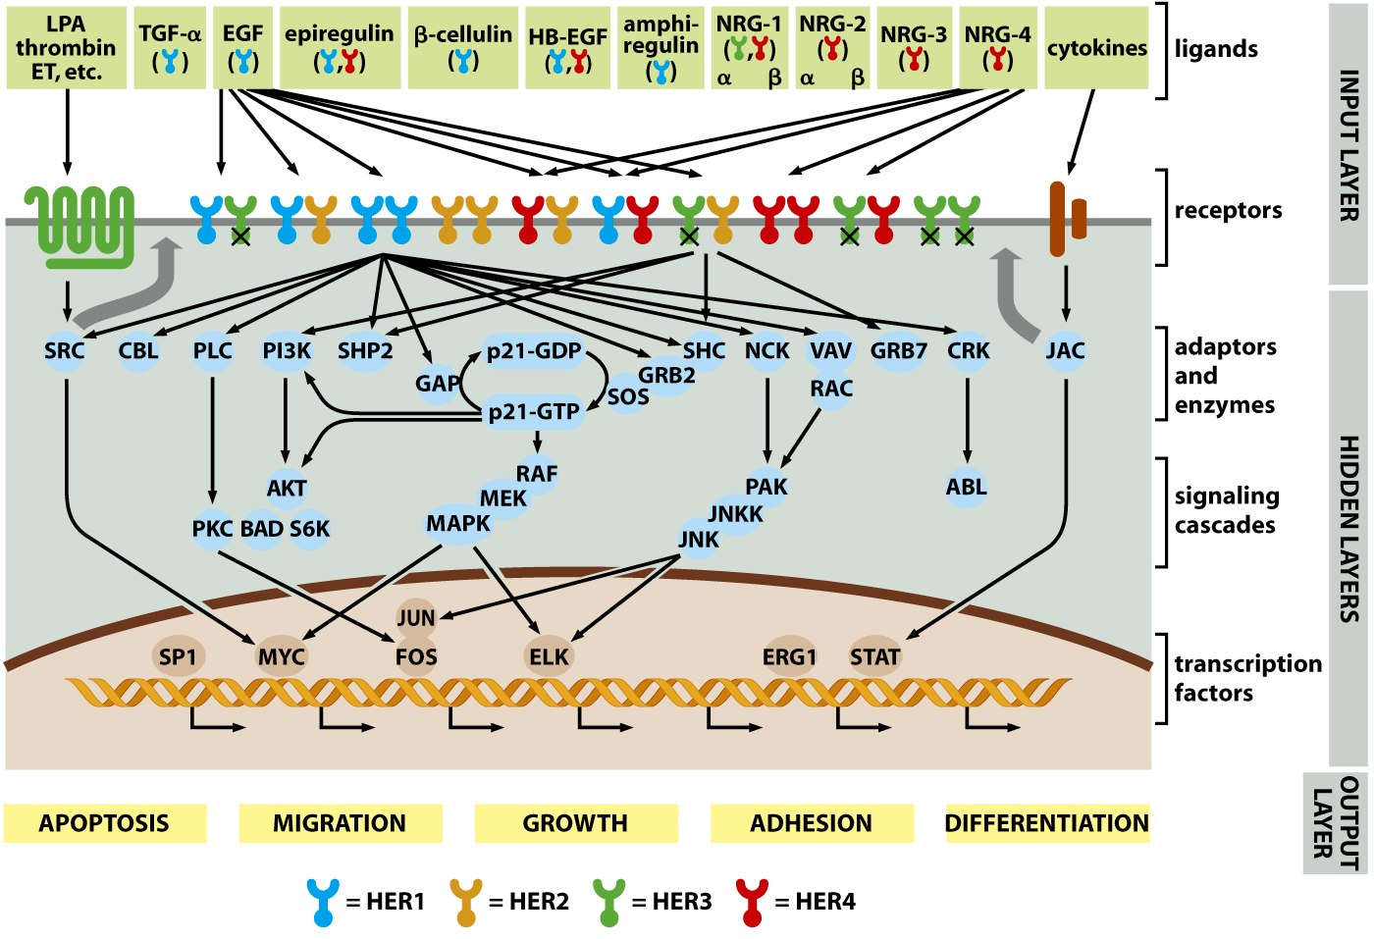
Virtually every type of protein involved in cell division signaling could be a potential oncogene. Help me explain this figure.

Slide 5
According to the figure, what type of protein does MYC encode?
Where would you expect to see RAS proteins in the picture.
How does RAS pass on the signal for growth/division in the pathway?

Slide 6
RAS mechanism

Slide 8
Recall
Binding of a mitogen (like PDGF or EGF) usually causes autophosphorylation of the receptor.
This occurs on the receptors’ cytoplasmic portion—which is conserved in many type of GF receptors. A specific tyrosine gets phosphorylated in response to binding of a specific GF.

Slide 9
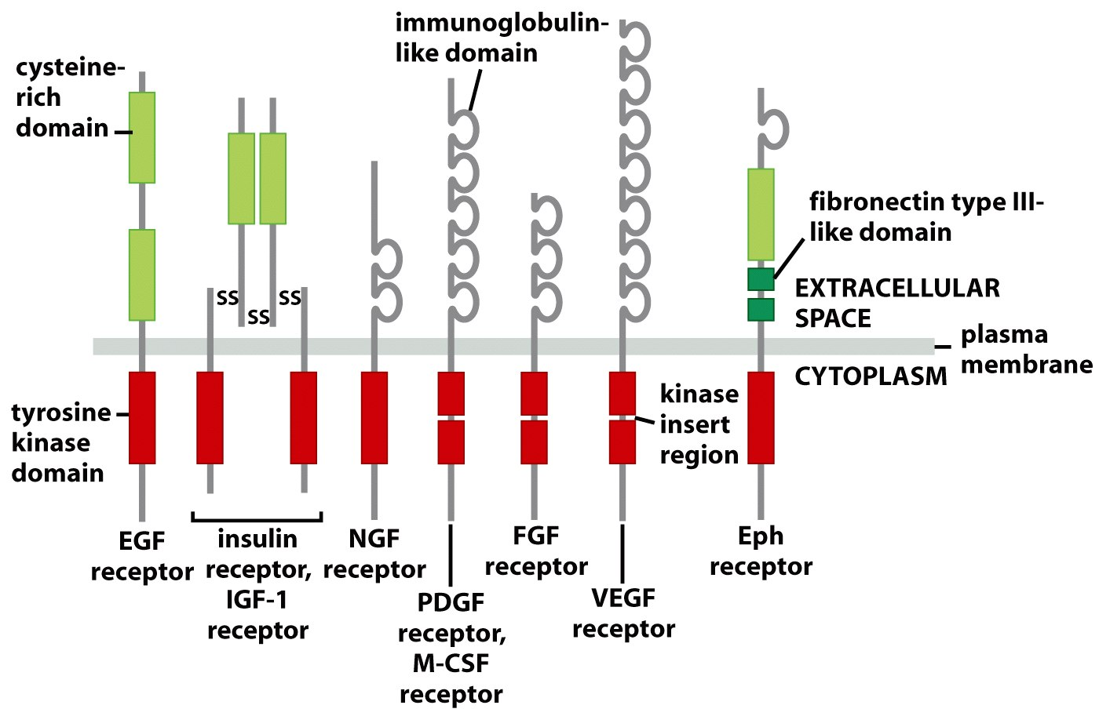
Some receptor tyrosine kinases
Figure 5.10 The Biology of Cancer (© Garland Science 2007)

Slide 10
Figure 5.10 The Biology of Cancer (© Garland Science 2007)

Slide 11
A common signal which activates the tyrosine protein kinase is dimerization of individual receptors.

Slide 12
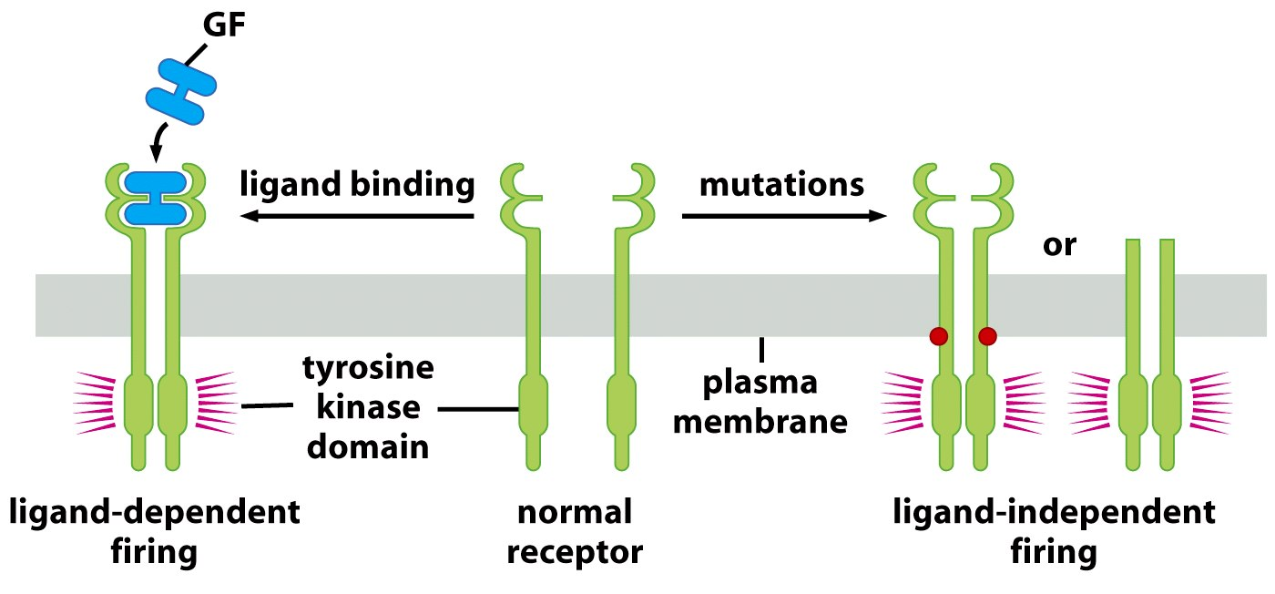
“ligand” is something that binds a receptor
Figure 5.12a The Biology of Cancer (© Garland Science 2007)

Slide 13
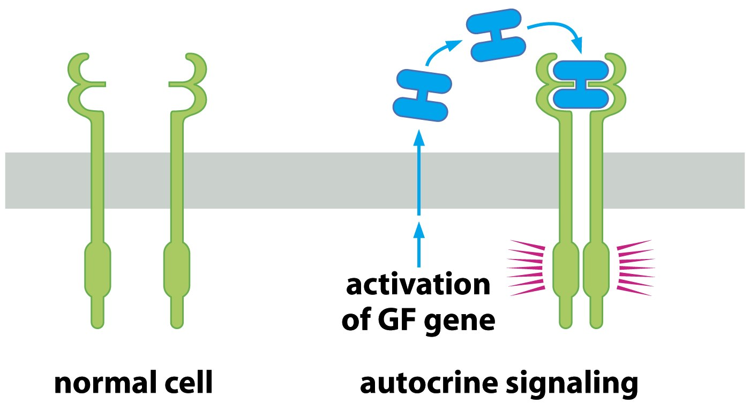
GF released by other cells=paracrine signaling.
Figure 5.12b The Biology of Cancer (© Garland Science 2007)

Slide 15
Other receptors require a different tyrosine kinase to phosphorylate them.
Jak-STAT pathway.
Jak is not part of the receptor, but is required to phosphoylate the receptor.
STAT interacts with phosphorylated receptor. Phosphorylated STAT can enter nucleus and activate transcription.

Slide 16
Virtually every type of protein involved in cell division signaling. Help me explain this figure.

Slide 17
Final category of oncoproteins
Direct cell cycle promoters and cell survival proteins—
Cyclins/CDKs—Since these are one of the ultimate end products of signal transduction, overproduction, or hyperactivity of these proteins also leads to cancer.
Anti-apoptotic proteins/survival proteins

Slide 18
BCL2
BCL2—encodes a cell survival protein, Bcl2 which associates with mitochondria.
A chromosome translocation in non-Hodgkins lymphoma cells greatly increases expression of BCL2. t(14;18) It places Bcl-2 right next to IgH gene promoter! (Similar to MYC translocation---review this!)
Cells expressing excess Bcl2 protein keep dividing rather than responding to apoptosis signals…

Slide 19
MDM2
Another gene which encodes a protein that promotes survival/inhibits apoptosis
Both MDM2 and BCL2 are discussed in more depth in the next chapter.

Slide 20
Recall tumor progression requires acquisition of several genetic alterations.
Tumor cells often show combinations of oncogenes which seem to enhance cell proliferation and keep the cell from resonding to apoptoic signals--- and together are poor prognostic indicators.

Slide 21
Experiments can be done in which one or more oncogenes are introduced into mice. (either by selective mutation or infection with viral forms of oncogenes)---or transposons!
What are reports called in the next slide? What conclusions can you draw from the following graphs?

Slide 22
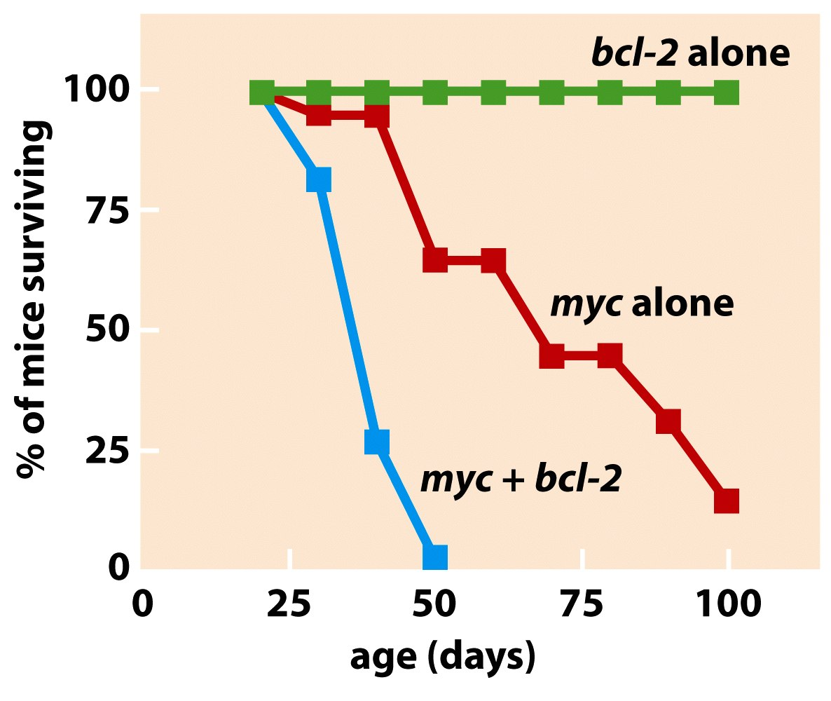
Figure 9.22b The Biology of Cancer (© Garland Science 2007)

Slide 23
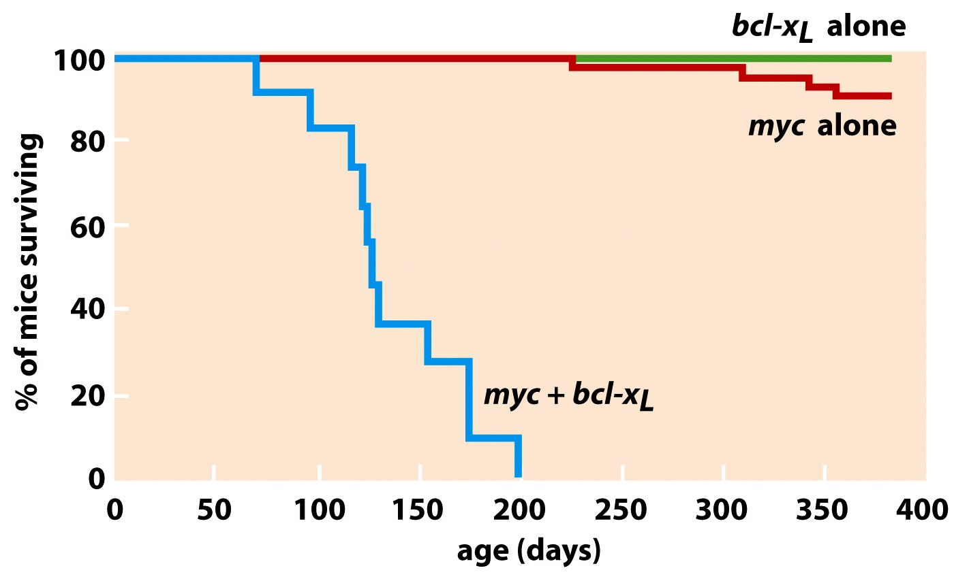
(A relative of bcl-2)

Slide 24
Let’s change gears—chpt. 11
Tumor suppressor genes
Akin to the brakes for cell cycle progression or involved in cell death.
Tumor suppressor genes were identified after oncogenes were discovered.
First clues came from experiments of somatic cell hybrids

Slide 25
Figure 10-1
Fusion of cancer cell with normal somatic cell
Nuclei fuse—initially the cell contains chromosomes from both cells.
Hypothesis? What do you think would happen if you fused a cancer cell and a normally dividing cell?

Slide 26
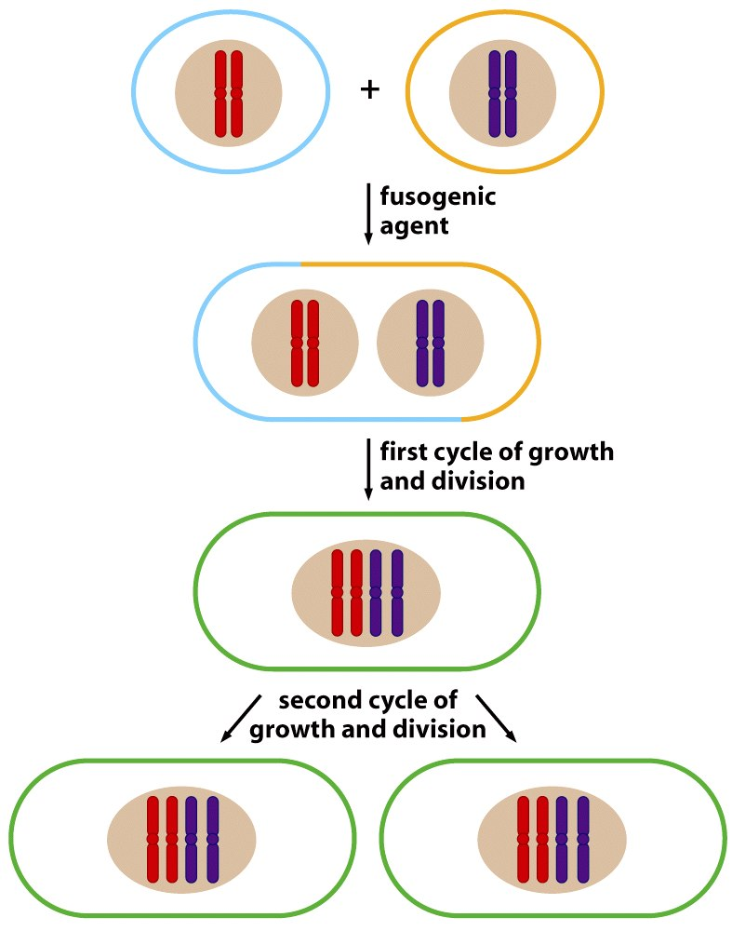
Cancer cell
Normal cell
Early daughter cells of the hybrid return to normal growth
Figure 7.1 The Biology of Cancer (© Garland Science 2007)

Slide 27
Hybrid cell resumes normal growth and fails to form tumors in animals.
Even cells with known active oncogenes (like RAS) seemed to be “tamed” by the fusion with a normal cell.

Slide 28
New hypothesis…
Normal cells express tumor inhibitors. Genes must exist that can combat the effects of an oncogene, protecting the cell from unregulated growth.

Slide 29
Longer term studies…
The somatic cell hybrids eventually began to show characteristics of cancer cells
accelerated cell division, tumorigenicity.

Slide 30
The changes were always associated with loss of chromosomes from the hybrid cells.
Logical approach to finding “protective” TS genes
Identify which chromosomes are lost from the immortal cell hybrids
Identify frequently lost/deleted segments of DNA within those chromsomes.

Slide 31
The first described TS gene
Found in families that exhibit high frequency of childhood eye cancer called retinoblastoma.
Child has many tumors
The tumors may occur in both eyes (bilateral)
Family members shown to share an inherited loss of specific region of chromosome 13.
**recall inherited cancers are rare.

Slide 32
Compelling evidence that this cancer is inherited!
Figure 7.5b The Biology of Cancer (© Garland Science 2007)

Slide 33
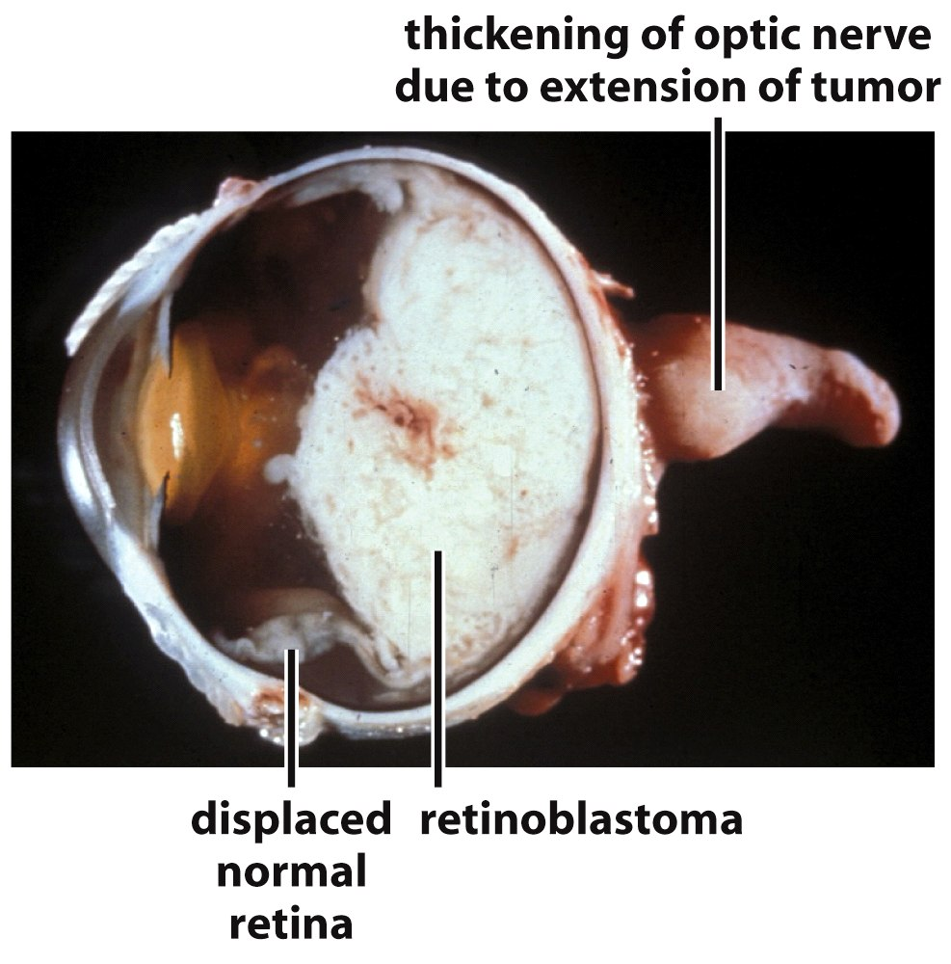
Figure 7.4b The Biology of Cancer (© Garland Science 2007)

Slide 34
This type of tumor is seen rarely in individuals without a family history, but when it is it is called a sporadic/spontaneous retinoblastoma[Rb])
In sporadic Rb, the eye tumors are only in one eye. (unilateral) The child usually only has one tumor.

Slide 35
Study of retinoblastoma gave rise to something called the “two-hit” model for cancer development proposed in 1971 by Alfred Knudson.
It explained the difference in familial and sporadic Rb and lead to identification of the first tumor suppressor gene.

Slide 36
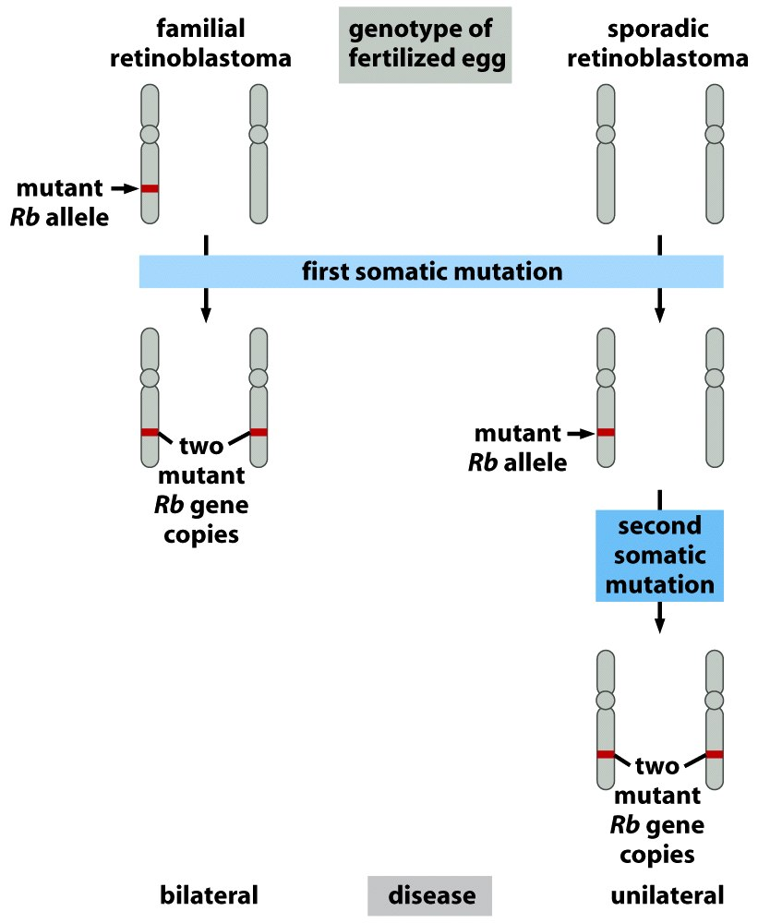
In familial Rb, the Rb mutation is in the germ line—in egg/sperm, so every cell of the offspring has one mutated Rb gene from birth—any cell receiving a second “hit” (loss of function mutation) to Rb will lose RB protein function.
In sporadic Rb, the individual inherited normal wild-type alleles for Rb, both of which had to be “hit” (muated) for RB to occur.
Figure 7.7 The Biology of Cancer (© Garland Science 2007)

Slide 37
Critical thinking…
Why is familial retinoblastoma bilateral, and sporadic retinoblastoma unilateral?
Whis is this disease a childhood cancer?
Why is there typically only one tumor in sporadic Rb and many in familial Rb?

Slide 38
Familial cancers
Knudson’s hypothesis helped explain this new type of cancer gene and a different type of cancer.
Explained this and other familial cancer syndromes (chapter 8)
Inheriting one mutated copy of RB in every cell decreases the need for time to acquire that mutation.
Inheriting one mutated copy of RB in every cell puts every cell at higher risk for a second mutation.

